Slide 1
Welcome to Key Club
Don’t forget to sign in!

Slide 2
Please stand for the pledge
I pledge on my honor to uphold the objects of Key Club International; to build my home, school, and community; to serve my nation and God; and combat all forces which tend to undermine these institutions.

Slide 3
Welcome OUR Special Guests
If you didn’t already notice, we have some special guests with us today
Alé Delgado is Division 11’s Lieutenant Governor
Mr. Bill Sears is our new Kiwanis Advisor
Formally it was Mr. Randy Bellamy but he’s been too busy to come out

Slide 4
Past Event: Division 11 Council Meeting
This month’s DCM (this Wednesday) had our biggest member turn out, EVER!
We had 9 members attend the meeting
It was one person’s first time attending
For those who attended, how was your experience? Any comments?
When volunteering, please say your name and grade!

Slide 5
Past Event: Chula Vista Welfare Council’s Food Drive
For those who went, please share your experience
Please say your name and grade!
If you did attend and did take pictures, please sent them to the club email: bvhs.cnhkc@gmail.com

Slide 6
Event: Division 11 Council Meeting (DCM)
January (Joint DCM/Conclave)
Who: At least 50% of the clubs from Division 11
What: Conclave is the time for the candidates to tell the division why he or she should be elected as LTG for the next term
When: January 19th from 10am – 12pm
Where: Helix High School (more info soon!)
Why: To vote and elect the upcoming Lieutenant Governor who will take over our current LTG’s position in the following term
A better reason why to go: If no more than 50% of the clubs present, then clubs may not vote

Slide 7
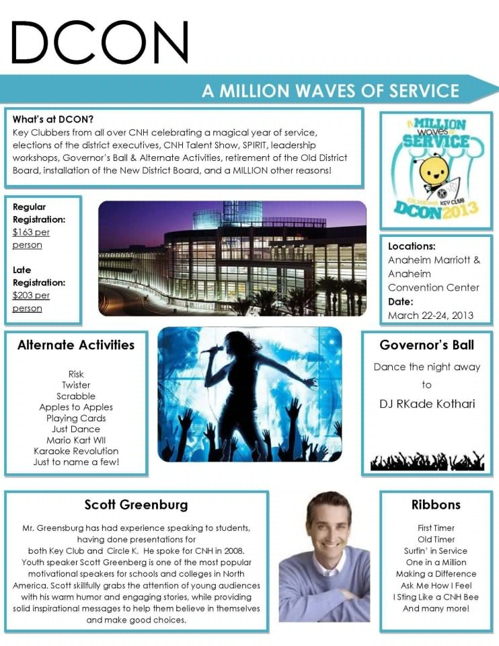
Event: dcon continued

Slide 8
Service Event: Forester Creek Clean Up
Volunteers needed to help cleanup trash from East County’s waterways
What: To help East County clean up Forester Creek from rain storm trash and debris
When: Saturday December 8th from 9am to 12pm
Where: Santee Public Works building
9534 Via Zapador Santee, CA
What you should wear: Sturdy clothing that can get dirty and closed shoes
Hat and sunscreen are recommended
No experience necessary; tools and supplies are provided

Slide 9
Service Event: Point Loma Gardening and Clean Up

Slide 10
Service Event: Christmas Dinner Baskets
The Bonita Kiwanis Club will do another food basket distribution and we’re invited!
Volunteers needed to help deliver Christmas Dinner Baskets
What: We help make dinner baskets for families and then deliver it to their homes
When: Saturday December 22nd at 9am
Where: Von’s in the Eastlake Shopping Center
Why: It makes people’s Christmas and you can get involved with K-Kids, Eastlake and San Ysidro Key Clubs, and especially our Bonita Kiwanis

Slide 11
Service Event: rose Float parade
Volunteers needed to help decorate floats
Who: Any Key Clubber 13 years or older
What: Rose Float Decoration, you come and help decorate the floats that will be presented at the annual parade
When: December 27th, the shifts are from 4-11pm
Buses will be at the Grossmont Center Parking lot next to the Claim Jumper Restaurant at 11:30, be there by 11:00am - DON’T BE LATE
Where: Rose Pavilion (Across from the Rose Bowl) in Pasadena
Why: It’s a unique event where both Division 11 and 31 volunteers

Slide 12
Fundraiser event: Krisy Kreme Doughnuts
What are we doing?
We’re going to be selling Krispy Kreme Doughnuts before and after school
When does this start?
We’re going to start our sales this upcoming Monday, December 10th
What needs to be done?
We encourage members to help volunteer before and after school to help sell doughnuts
Another, can we get a couple members to help advertise by making posters?
Where will the money go?
The money goes toward: PTP, Project eliMiNaTe , DCON, and club shirts

Slide 13
Fundraiser Event: Holiday Grams
What are we doing?
We’re going to be selling Holiday Grams since Christmas break is approaching and why not end the year with a gram?
When does this start?
We’re going to start our sales this upcoming Monday, December 10th and they will be distributed on the last day before break, December 21st
What needs to be done?
It would be great if we can get members to advertise/create posters
Where will the money go?
The money goes toward: PTP, Project eliMiNaTe , DCON, and club shirts

Slide 14
Fundraiser Event: League of Legends
This event was created by the D37E
Proceeds will go to Project eliMiNaTe which provides funds for eliminating MNT in developing countries
Registration is $5 per player
Tournament will take place from December 31st to January 5th depending on how many teams are signed up
It will be a 5v5 bracket style
ANYONE can participate in this event, non-Key Clubbers are welcomed!
There will be a prize, the prize is determined by the amount of participating teams
If you ARE interested, email: DASUPRAZN@gmail.com with
Name of the team
Name of team’s members (user and real name)
Which club and division you belong to

Slide 15
Shirts: Any ideas?
If you have any ideas, send it to our email: bvhs.cnhkc@gmail.com
Shirt designs will be due before winter break starts so that we can have shirts by second semester!
An example is below, Mar Vista’s Club Shirt

Slide 16
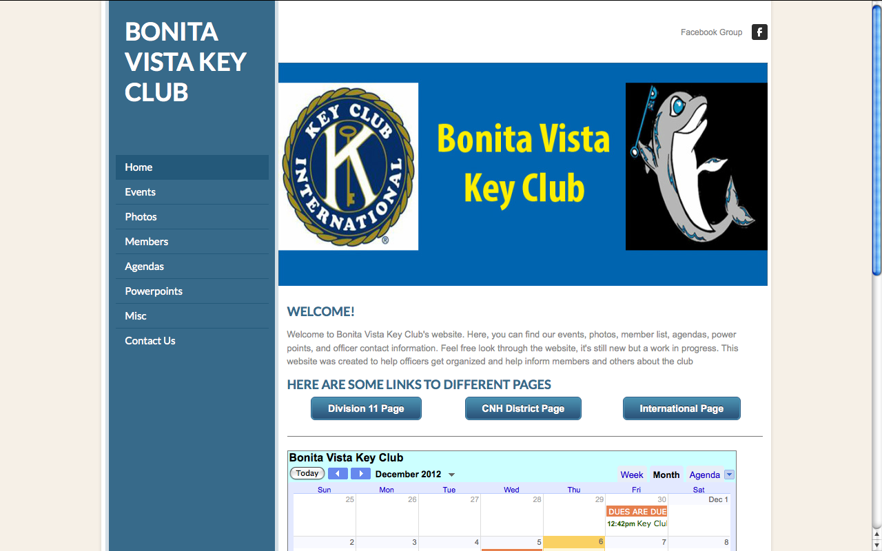
AMAZING NEWS!!
We didn’t want to let you guys know until now but…
WE NOW HAVE OUR OWN CLUB WEBSITE!!!
The link: bonitavistakeyclub.weebly.com

Slide 17
Key club Member of the Month!
This past month, us officers have decided to choose one of you as Key Club Member of the Month
Our Key Clubber of the Month is Ziamara Iglesias!
Reasons why she’s November’s Key Clubber of the Month
[insert here]

Slide 18
Contact Information/Resources
President: Chanel Moinat
Email: moinatchanel@yahoo.com
Number: (619) 347-1216
Vice-President: Brandon Isaaks
Email: bisaaks@hotmail.com
Number: (619) 651-5463
Secretary: Hershey Guzman
Email: guzman.hershey@gmail.com
Number: (619) 212-1997
Treasurer: Gabe Otero
Email: gabeotero@gmail.com
Number: (619) 212-6589
Club email: bvhs.cnhkc@gmail.com
Club website:
bonitavistakeyclub.weebly.com
Facebook Group: BVHS Key Club
If your not a member there already, let us know and we’ll add you!
Division 11 Website: d11dolphins.weebly.com
Need to contact the LTG?
Alé Delgado
D11.cnhkc.ltg@gmail.com

