Slide 1
Welcome to Key Club
Don’t forget to sign in!

Slide 2
Please stand for the pledge
I pledge on my honor to uphold the objects of Key Club International; to build my home, school, and community; to serve my nation and God; and combat all forces which tend to undermine these institutions.

Slide 3
Past social event: Bonita Kiwanis Breakfast

Slide 4
Past Event: Point Loma Gardening and Clean Up
We had 5 members come out to do the service project
Reflection?

Slide 5
Event: Division 11 Council Meeting (DCM)
January (Joint DCM/Conclave)
Who: At least 50% of the clubs from Division 11
What: Conclave is the time for the candidates to tell the division why he or she should be elected as LTG for the next term
When: January 19th from 10am – 12pm
Where: Helix High School (more info soon!)
Why: To vote and elect the upcoming Lieutenant Governor who will take over our current LTG’s position in the following term
A better reason why to go: If no more than 50% of the clubs present, then clubs may not vote

Slide 6
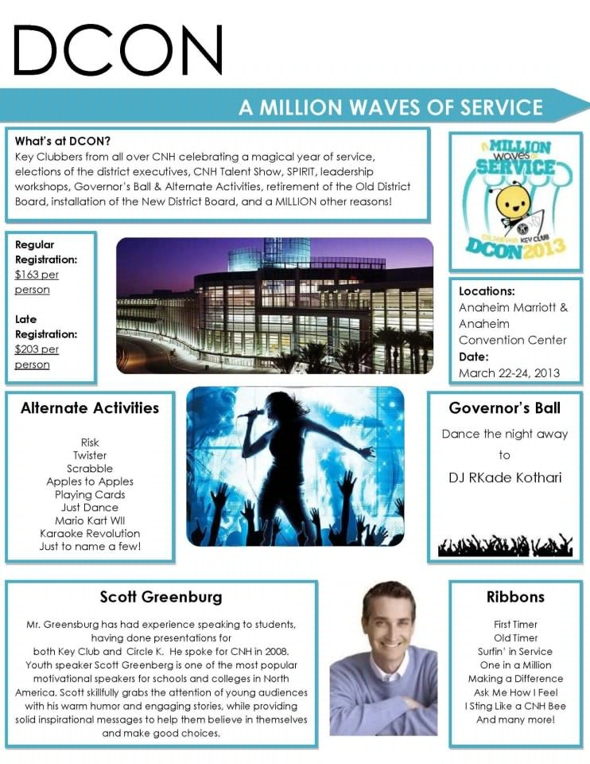
Event: dcon continued

Slide 7
Service Event: Christmas Dinner Baskets
The Bonita Kiwanis Club will do another food basket distribution and we’re invited!
Volunteers needed to help deliver Christmas Dinner Baskets
What: We help make dinner baskets for families and then deliver it to their homes
When: Saturday December 22nd at 9am
Where: Von’s in the Eastlake Shopping Center
Why: It makes people’s Christmas and you can get involved with K-Kids, Eastlake and San Ysidro Key Clubs, and especially our Bonita Kiwanis

Slide 8
Service Event: San Diego River Clean Sweep
Volunteers needed to help decorate floats
Who: All are welcome (including friends and family)
What: We will be walking along the San Diego River trail as a group to pick up trash and beautify the trail
When: January 12th from 9am – 12pm
Where: Along the San Diego River Trail
We will be picking a place to meet so leave your contact information!
Misc: Tools will be provided, but make sure to bring clothes that you can get dirty in. It might be a good idea to bring hats and sunscreen

Slide 9
Fundraiser Event: League of Legends
This event was created by the D37E
Proceeds will go to Project eliMiNaTe which provides funds for eliminating MNT in developing countries
Registration is $5 per player
Tournament will take place from December 31st to January 5th depending on how many teams are signed up
It will be a 5v5 bracket style
ANYONE can participate in this event, non-Key Clubbers are welcomed!
There will be a prize, the prize is determined by the amount of participating teams
If you ARE interested, email: DASUPRAZN@gmail.com with
Name of the team
Name of team’s members (user and real name)
Which club and division you belong to

Slide 10
Shirts: Any ideas?
If you have any ideas, send it to our email: bvhs.cnhkc@gmail.com
Shirt designs will be due during winter break starts so that we can have shirts by second semester!
We have 3 shirt design entries in! They will be posted on the website sometime soon

Slide 11
Misc: membership cards and certificates
Earlier this week, membership cards came in along with certificates verifying that you are paid member
They will be issued out at the end of the meeting

Slide 12
Misc: Service Hours
If you are done any events that were mentioned during a meeting, please let our Secretary, Hershey know so that she can input in the Monthly Report and to be put on record

Slide 13
Contact Information/Resources
President: Chanel Moinat
Email: moinatchanel@yahoo.com
Number: (619) 347-1216
Vice-President: Brandon Isaaks
Email: bisaaks@hotmail.com
Number: (619) 651-5463
Secretary: Hershey Guzman
Email: guzman.hershey@gmail.com
Number: (619) 212-1997
Treasurer: Gabe Otero
Email: gabeotero@gmail.com
Number: (619) 212-6589
Club email: bvhs.cnhkc@gmail.com
Club website:
bonitavistakeyclub.weebly.com
Facebook Group: BVHS Key Club
If your not a member there already, let us know and we’ll add you!
Division 11 Website: d11dolphins.weebly.com
Need to contact the LTG?
Alé Delgado
D11.cnhkc.ltg@gmail.com

